Slide 1
Pattern Recognition System Project
Project: Workplace Stress Level Detection System
By: WANG HONGTAO A0195158U
Yang Yizhou A0231320A
Date:28/08/2021

Slide 2
Agenda
ONE
TWO
THREE
Project Background
Introduce benefits derived by this Project
Introduce our project:
workplace stress level detection system

Slide 3
PART ONE
Project Background

Slide 4
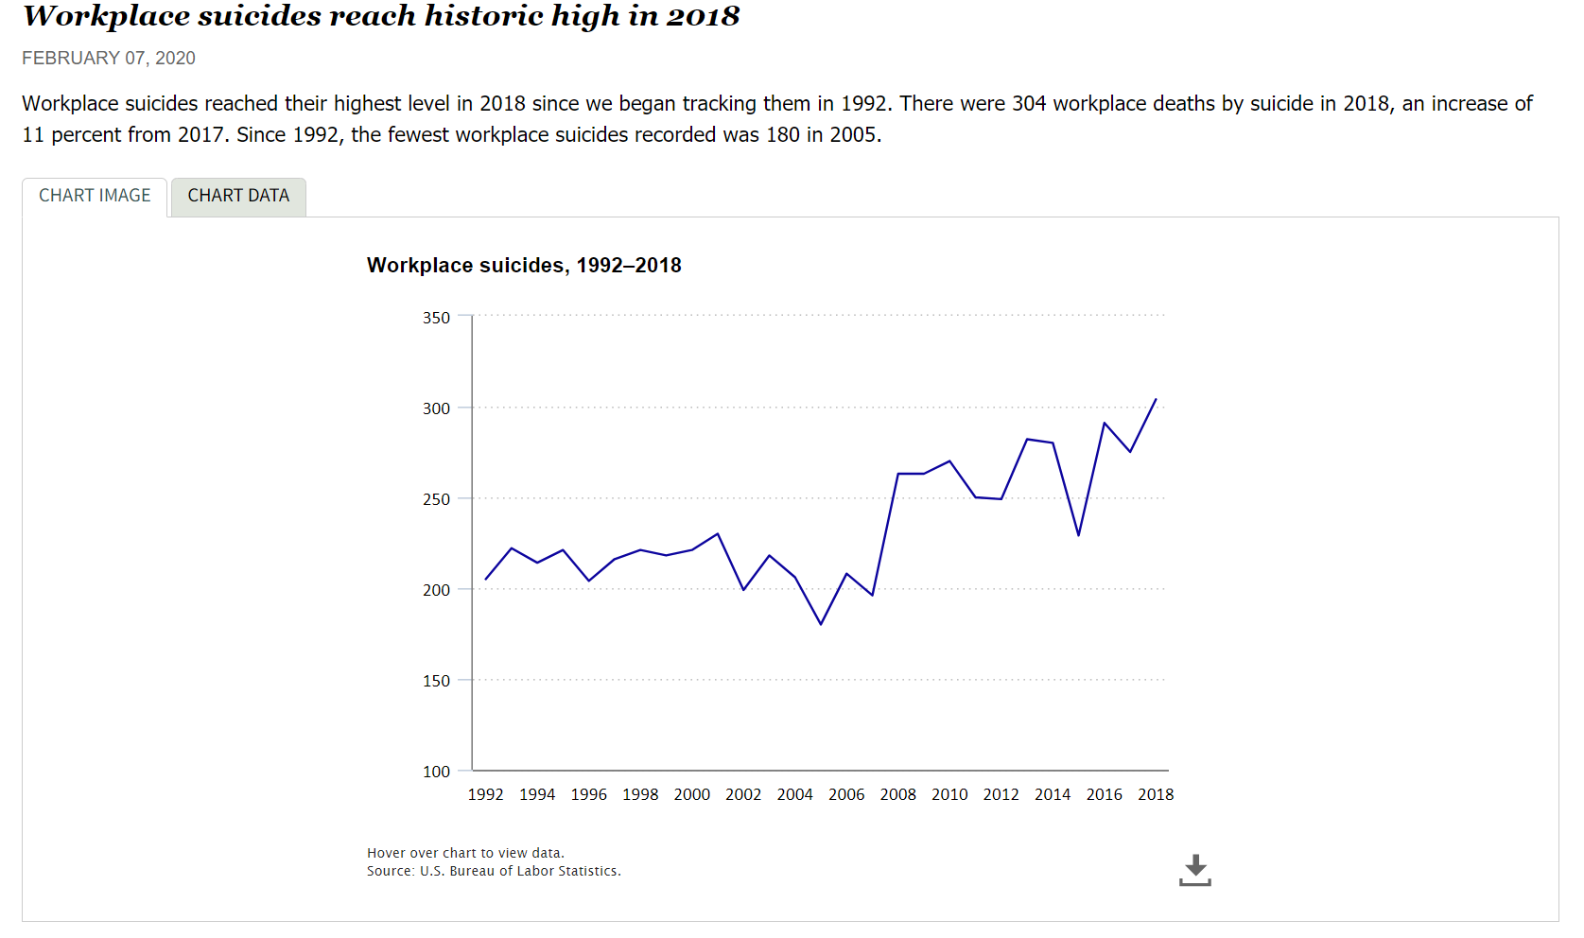
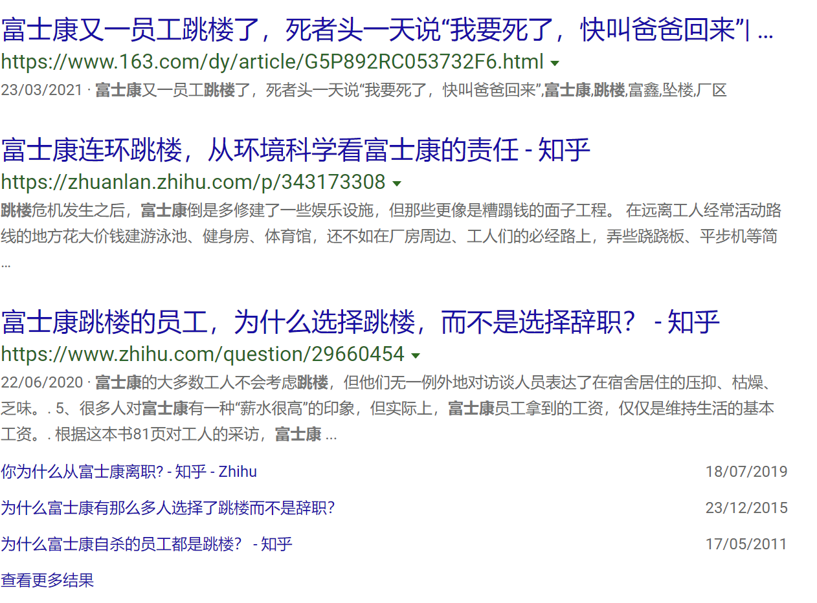
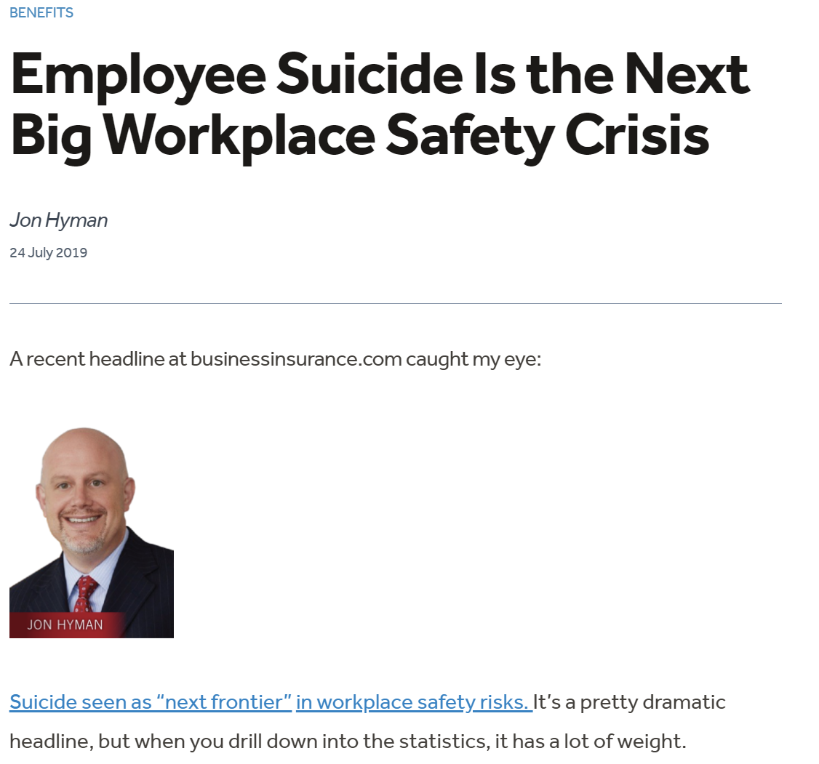
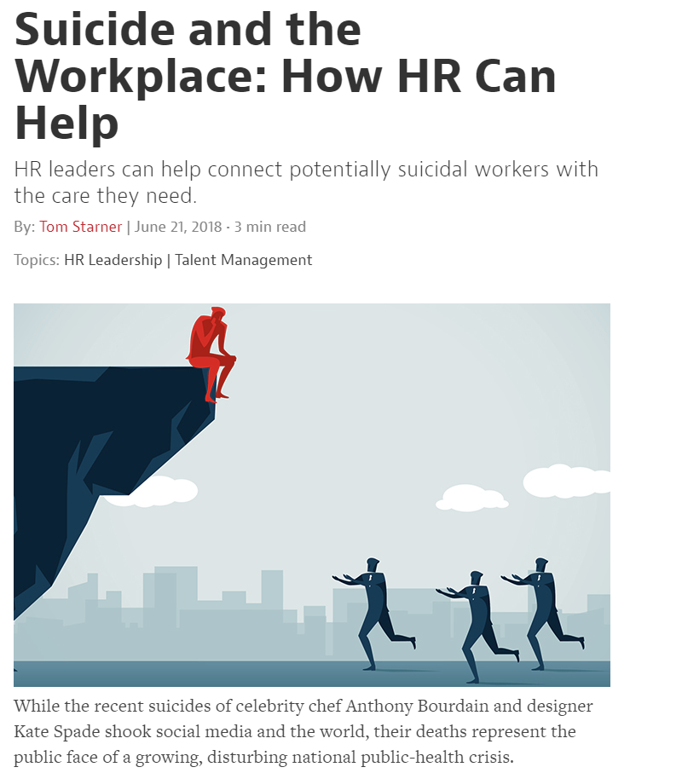
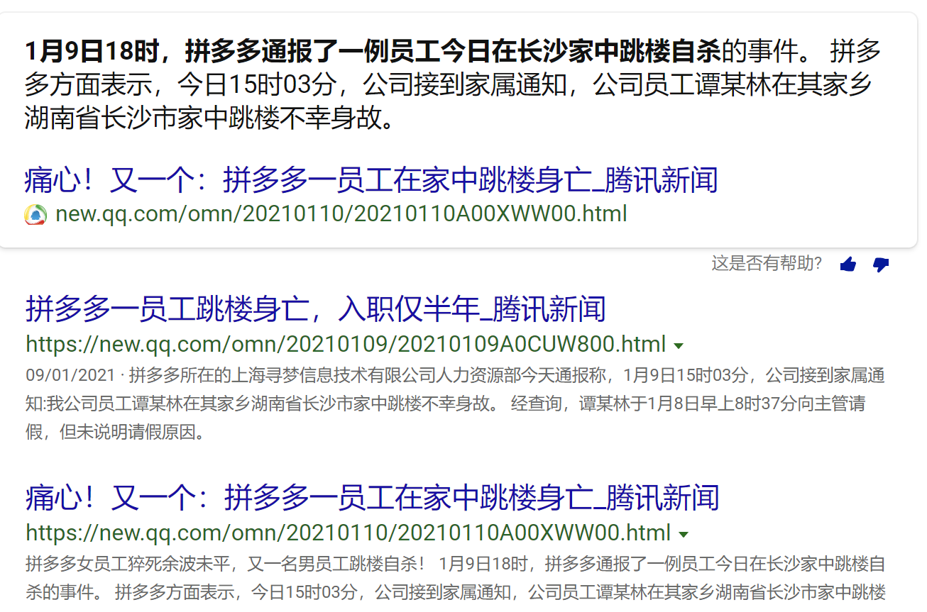
Notes:
let’s watch some news

Slide 5
So we decided to build a project which can help us detect the pressure in the workplace.
Our team consider it can help the staff physical and mental health.

Slide 6
PART Two
Introduce benefits derived by this Project

Slide 7
Staff:
Most of the time, people do not realize that they are stressed, and do not know how to adjust their stress, so the intervention of the outside is particularly important.
Employer:
They can evaluate the employees’ stress by comparing the assigned work and analyze whether the causes of stress are from workloads or other aspects. And they can decide to reduce or add work tasks to employees.
HR:
Identify and intervene as early as possible when the employee has troubles, and help them timely before things get worse.

Slide 8
PART Three
Introduce our project: Workplace Stress Level Detection System

Slide 9
Flow chart:
Input: video(from monitors or webcam
facial recognition model
Step 1: Extracting face regions
Emotion recognition model
Step 2: Generate time series of emotion
Hidden Markov Model
Step 3: Reason pressure level from a Hmm model
Report Generator
Step 4: Generate a report
Output: Report

Slide 10
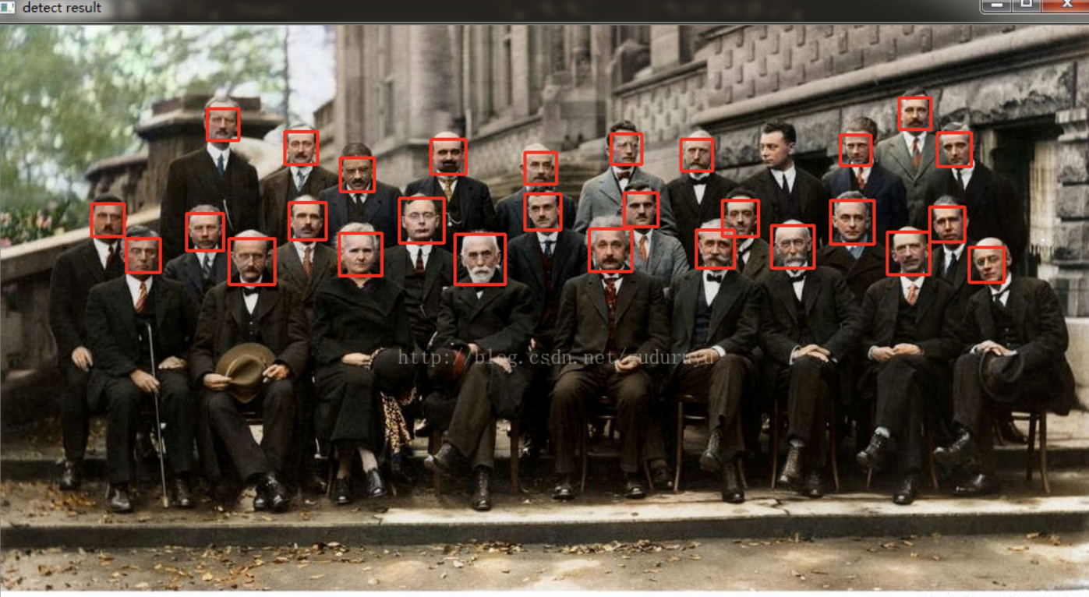
Step 1: Facial Recognition(OpenCV haar cascadeclassifier)
Notes:
First locate the face and then label the face(name).

Slide 11
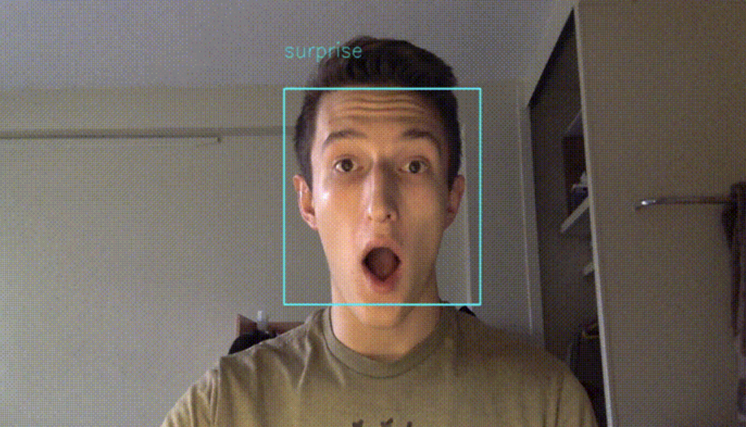
Step 2 Emotion recognition(CNN)
Dataset: Challenges in Representation Learning: Facial Expression Recognition Challenge | Kaggle
Notes:
Input the face pixels from Part 1 and recognize the emotion.(
Emotion: Happy, Unhappy, Normal
A: Happy(H)
B: Unhappy(U)

Slide 12
Step 3 series of emotions(HMM)
 | high | mid | low
high | 0.8 | 0.1 | 0.1
mid | 0.1 | 0.8 | 0.1
low | 0.1 | 0.1 | 0.8
 | Happy | Neutrality | Unhappy
high | 0.1 | 0.1 | 0.8
mid | 0.1 | 0.8 | 0.1
low | 0.8 | 0.1 | 0.1
1 2 3 4 5 6 7
A: H U H U H H H
B: N U U U U N H
1 2 3 4 5 6 7
A: H M L M M M L
B: M H H H H H L
Notes:
We pick up several pictures from the video streams such as we choose one picture every 5 seconds and detect the person and the emotion. If the video streams are 5 minutes. We can collect 60 pictures which display who the person is and what emotions that he/they have.
Then we can get a time series of emotions.(Happy->H, Normal->N, Unhappy->U)

Slide 13
Step 4 Generate a report
Name | Stress level
Wang Hongtao | H
Yang Yizhou | L
For managers, based on the report, they can evaluate the pressure by comparing the assigned work and roughly conclude whether the causes of pressure are from workloads or other aspects. Managers can decide to reduce or add work tasks to employees.
For the HR department, based on this report, they can find some potentially stressed employees in a more timely manner, and send them timely care before things get worse.

Slide 14

Q & A

